Slide 1



Data Aggregation
How to get data insights?
SoftUni Team
Technical Trainers
Software University
http://softuni.bg
1

Slide 2
Table of Content
Grouping – consolidating data based on criteria
Aggregate Function – COUNT, SUM, MAX, MIN, AVG …
Having – using predicates while grouping
2

Slide 3
Questions
sli.do #JavaDB
3

Slide 4

Grouping
Consolidating data based on criteria

Slide 5
Grouping
Grouping allows taking data into separate groups based on a common property
Grouping column
employee | department_name | salary
Adam | Database Support | 5,000
John | Database Support | 15,000
Jane | Application Support | 10,000
George | Application Support | 15,000
Lila | Application Support | 5,000
Fred | Software Support | 15,000
Can be aggregated
5

Slide 6
GROUP BY
With GROUP BY you can get each separate group and use an "aggregate" function over it (like Average, Min or Max):
SELECT e.`job_title`, count(employee_id)
FROM `employees` AS e
GROUP BY e.`job_title`;
Grouping
Columns
6

Slide 7
Problem: Departments Total Salaries
Write a query which prints the total sum of salaries for each department in the soft_uni database
Order them by DepartmentID (ascending)
employee | department_name | salary
Adam | Database Support | 5,000
John | Database Support | 15,000
Jane | Application Support | 10,000
George | Application Support | 15,000
Lila | Application Support | 5,000
Fred | Software Support | 15,000
department_id | total_salary
1 | 20,000
2 | 30,000
3 | 15,000
7

Slide 8
Solution: Departments Total Salaries
Grouping Column
New Column Alias
SELECT e.`department_id`,
SUM(e.`salary`) AS 'Total Salary'
FROM `employees` AS e
GROUP BY e.`department_id`
ORDER BY e.`department_id`;
Table Alias
Grouping Columns
8

Slide 9

Aggregate Functions
COUNT, SUM, MAX, MIN, AVG…

Slide 10
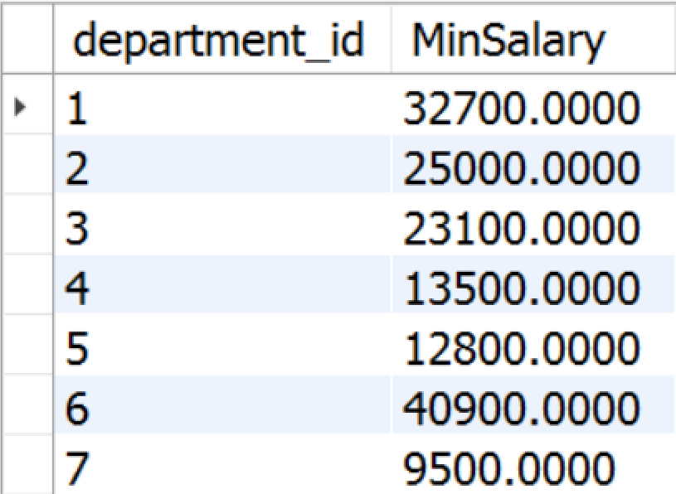
Aggregate Functions
Used to operate over one or more groups performing data analysis on every one
MIN, MAX, AVG, COUNT etc.
They usually ignore NULL values
SELECT e.`department_id`,
MIN(e.`salary`) AS 'MinSalary'
FROM `employees` AS e
GROUP BY e.`department_id`;
10

Slide 11
COUNT
COUNT - counts the values (not nulls) in one or more columns based on grouping criteria
employee | department_name | salary
Adam | Database Support | 5,000
John | Database Support | 15,000
Jane | Application Support | 10,000
George | Application Support | 15,000
Lila | Application Support | 5,000
Fred | Software Support | 15,000
department_name | SalaryCount
Database Support | 2
Application Support | 3
Software Support | 1

Slide 12
COUNT Syntax
Note that we when we use COUNT we will ignore any employee with NULL salary.
Grouping Column
New Column Alias
SELECT e.`department_id`,
COUNT(e.`salary`) AS 'Salary Count'
FROM `employees` AS e
GROUP BY e.`department_id`;
Grouping Columns

Slide 13
SUM
SUM - sums the values in a column
employee | department_name | salary
Adam | Database Support | 5,000
John | Database Support | 15,000
Jane | Application Support | 10,000
George | Application Support | 15,000
Lila | Application Support | 5,000
Fred | Software Support | 15,000
department_name | total_salary
Database Support | 20,000
Application Support | 30,000
Software Support | 15,000

Slide 14
SUM Syntax
If any department has no salaries NULL will be displayed.
Grouping Column
New Column Alias
SELECT e.`department_id`, SUM(e.`salary`) AS 'TotalSalary'
FROM `employees` AS e
GROUP BY e.`department_id`;
Table Alias
Grouping Columns

Slide 15
MAX
MAX - takes the maximum value in a column.
employee | department_name | salary
Adam | Database Support | 5,000
John | Database Support | 15,000
Jane | Application Support | 10,000
George | Application Support | 15,000
Lila | Application Support | 5,000
Fred | Software Support | 15,000
department_name | max_salary
Database Support | 20,000
Application Support | 30,000
Software Support | 15,000
Notes:
NULLs are ignored again.

Slide 16
MAX Syntax
Grouping Column
New Column Alias
SELECT e.`department_id`, MAX(e.`salary`) AS 'MaxSalary'
FROM `employees` AS e
GROUP BY e.`department_id`;
Table Alias
Grouping Columns

Slide 17
MIN
MIN takes the minimum value in a column.
employee | department_name | salary
Adam | Database Support | 5,000
John | Database Support | 15,000
Jane | Application Support | 10,000
George | Application Support | 15,000
Lila | Application Support | 5,000
Fred | Software Support | 15,000
department_name | min_salary
Database Support | 5,000
Application Support | 5,000
Software Support | 15,000

Slide 18
MIN Syntax
Grouping Column
New Column Alias
SELECT e.`department_id`, MIN(e.`salary`) AS 'MinSalary'
FROM `employees` AS e
GROUP BY e.`department_id`;
Table Alias
Grouping Columns

Slide 19
AVG
AVG calculates the average value in a column.
employee | department_name | salary
Adam | Database Support | 5,000
John | Database Support | 15,000
Jane | Application Support | 10,000
George | Application Support | 15,000
Lila | Application Support | 5,000
Fred | Software Support | 15,000
department_name | average_salary
Database Support | 10,000
Application Support | 10,000
Software Support | 15,000

Slide 20
Demo: AVG Syntax
Grouping Column
New Column Alias
SELECT e.`department_id`,
AVG(e.`salary`) AS 'AvgSalary'
FROM `employees` AS e
GROUP BY e.`department_id`;
Table Alias
Grouping Columns

Slide 21
Having
Using predicates while grouping
Notes:
The HAVING clause is used to filter data based on aggregate values. This means that we cannot use it without grouping before that. Unlike HAVING, the WHERE clause filters rows before the aggregation happens.

Slide 22
Having Clause
The HAVING clause is used to filter data based on aggregate values.
We cannot use it without grouping before that
Any Aggregate functions in the "HAVING" clause and in the "SELECT" statement are executed one time only
Unlike HAVING, the WHERE clause filters rows before the aggregation

Slide 23
Having Clause: Example
Filter departments which have total salary more or equal 15,000.
Aggregated value
employee | department_name | salary | Total Salary
Adam | Database Support | 5,000 | 20,000
John | Database Support | 15,000
Jane | Application Support | 10,000 | 10,000
George | Application Support | 15,000
Lila | Application Support | 5,000
Fred | Software Support | 15,000 | 15,000
department_name | average_salary
Database Support | 10,000
Software Support | 15,000

Slide 24
HAVING Syntax
Grouping Column
Aggregate Function
SELECT e.`department_id`, SUM(e.salary) AS 'TotalSalary'
FROM `employees` AS e
GROUP BY e.`department_id`
HAVING `TotalSalary`< 250000;
New Column Alias
Grouping Columns
Having Predicate

Slide 25

Summary
…
…
…
Grouping
Aggregate Functions
Having
SELECT
SUM(e.`salary) AS 'TotalSalary'
FROM `employees` AS e
GROUP BY e.`department_id`
HAVING SUM(e.`salary`) < 250000;

Slide 26
https://softuni.bg/trainings/courses

Slide 27













SoftUni Diamond Partners

Slide 28





SoftUni Organizational Partners

Slide 29




Trainings @ Software University (SoftUni)
Software University – High-Quality Education and Employment Opportunities
softuni.bg
Software University Foundation
http://softuni.foundation/
Software University @ Facebook
facebook.com/SoftwareUniversity
Software University Forums
forum.softuni.bg

Slide 30

License
This course (slides, examples, demos, videos, homework, etc.) is licensed under the "Creative Commons Attribution-NonCommercial-ShareAlike 4.0 International" license

